Slide 1

A nonprofit addressing food insecurity in Tempe, AZ

Slide 2

Board of Advisors
Veronica Macaulay
Veronica is a Teacher-turned-Graphic Designer who has worked in high-need schools and neighborhoods. She is passionate about combining her experience as a teacher with her expertise as a designer to help decrease food insecurity within the Tempe community.
Nicole Klukowski
Nicole has worked as a technical writer for a software company based in Tampa Bay for the last two years. She is working on completing her master’s in Technical Communication and is looking for an outlet like Food Security where she can use her communication skills to help the public.
Rebecca Hull
Rebecca is a senior at Arizona State University, majoring in Technical Communications and minoring in Project Management, and Digital Audiences. She enjoys employing the skills she’s learned creating online content and managing digital campaigns for a variety of companies and is excited to put them to use for Food Security.

Slide 3


Our Client
Susan Richey
Arizona Business Owner & Philanthropist

Slide 4
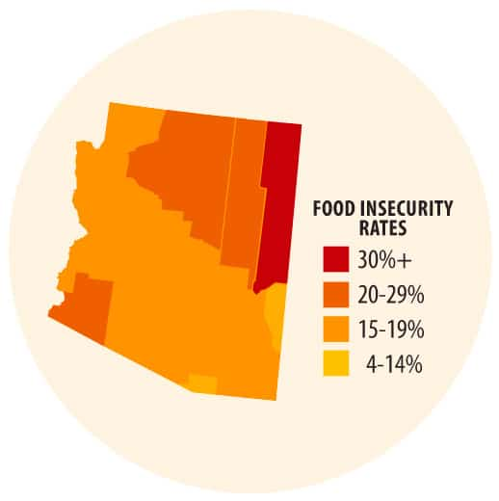
Food Insecurity
Arizona state

Slide 5
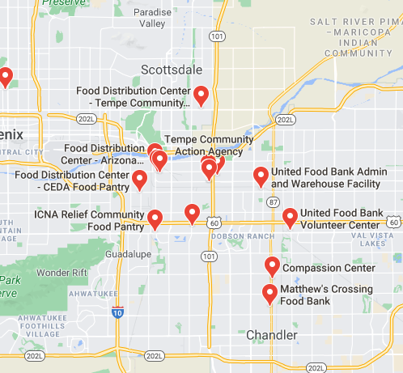

Consumers
We’ve identified the three food banks currently in operation in the neediest regions of Tempe, AZ. These food distribution centers are:
  ICNA Relief Community Food Pantry
  Tempe Community Action Agency
  CEDA Food Pantry
Map source: https://datausa.io/profile/geo/tempe-az/#economy

Slide 6
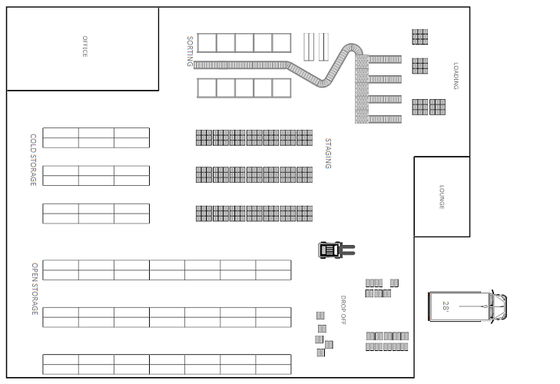
Warehouse Logistics

Slide 7
Tracking and Inventory
QuickBooks Enterprise or a similar inventory tracking system must be used.
Tracking is done through Barcode/SKU to sort inventory coming and going.
Incoming freight is unpacked, and each item scanned, entering the count into QuickBooks Enterprise.
Items are sorted into their respective places in the warehouse.
Utilize tracking system to allow online ordering of shipments and real-time updates.

Slide 8
Receiving
Transportation requires one 28-foot reefer truck that will use separate receiving and loading docks at the warehouse.
The truck backs into the receiving dock where the goods that are stacked on pallets and creates are unloaded by dolly or forklift.
The goods are staged in the “Drop Off” area of the warehouse.
Once the truck is unloaded, it can leave the dock after a signature confirms the receipt of ordered freight.
Items are sorted into their respective places in the warehouse by volunteers.
Dry, canned goods, and produce not needing refrigeration are stored in “Open Storage”.
Goods requiring refrigeration or freezing are stored in “Cold Storage”.

Slide 9
Shipping
Food banks in need can place orders online.
Each ordered item is individually scanned, removing it from the online inventory.
Items are packed into boxes and crates.
Boxes and crates are staged at the loading dock.
Freight is loaded onto the truck.

Slide 10
Staff Requirements
Employee 1
Responsible for administrative duties including recruiting volunteers, inventory, and sourcing/ordering foods and goods.
Employee 2
Responsible for managing volunteers, supervise the unloading and loading of food, scanning and sorting inventory, and cleaning.
Employee 3
Truck Driver responsible for the transportation of foods.

Slide 11
Volunteers
Volunteers will be able to sign up for a shift using the calendar tool on the company website.
Volunteers will assist with the day-to-day operations of the warehouse, including sorting items, scanning, and packing goods.
Volunteers will be given community service hours for their efforts.

Slide 12

Fundraising
Implement a donation program in your grocery stores. We suggest two methods, both processes are made simple because they are completed in one transaction when customers pay for their groceries.
1. Each time a customer pays for groceries, they are offered an opportunity to donate $1 - $10 to Food Security.
2. Each time a customer pays for groceries, they are given the option to round-up their total to the closest dollar amount and donate the change.

Slide 13
Thank You!
Food Security
A nonprofit addressing food insecurity in Tempe, AZ

